Slide 1
Instaventory
A convenience store inventory management solution
Olivier Chan
Luis Guerrero
Hiren Rathod
Yue Pan

Slide 2
What is Inventory Management (software)?
Inventory Management
The small or large scale control and overseeing of physical materials and goods.
Examples of use cases:
Helping to decide when to purchase new goods for retail
Calculating profits/margins
Can be accomplished with paper records, spreadsheets, software, etc.

Slide 3
Instaventory, our solution
Inventory Management software
Designed for individual, small scale stores
Gas stations
Convenience stores (7-Eleven, Liquor stores)
Features
Save and load data records from a file
Add and delete data records
View ordered lists of records
View records ordered by profit margin
And more!

Slide 4
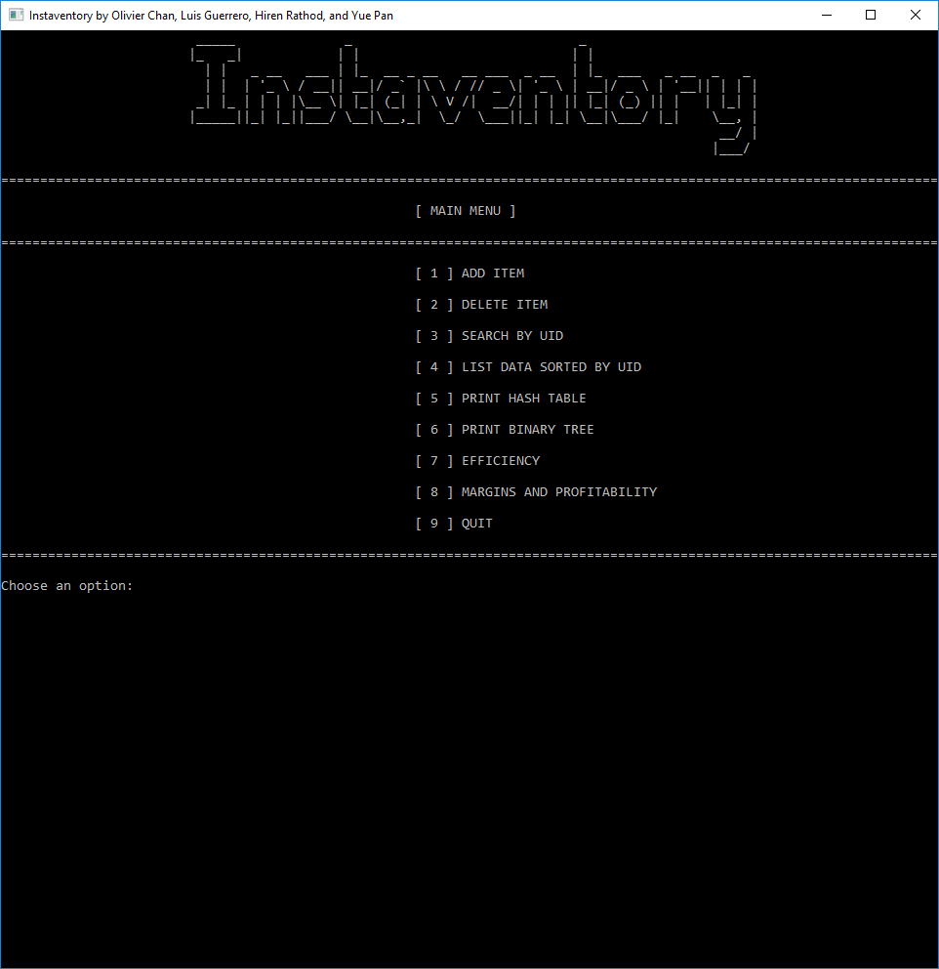
User Interface
Menu / Option based
Navigation by choosing a number option
Input validation
Can’t enter invalid options/data - reason will be given and asked to retry

Slide 5
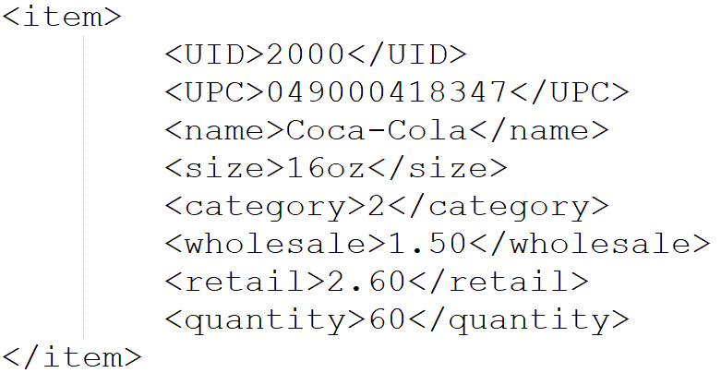
How Products/Items are stored in file
UID - Unique Identifier
UPC - Universal Product Code
A.K.A. Barcode
Name
Size (Number, Weight, Volume)
Category
Snacks
Drinks
Tobacco
Lottery & Scratch Cards
Miscellaneous
Wholesale / Retail Price
Quantity in Stock

Slide 6
Data Structures used in Instaventory
Dynamic Array (std::vector-like)
Used as the primary structure for storing data
All other ADTs reference from the dynamic array
Linked List
Used in general use cases
Used in hash table ADT for separate chaining
Hash Table
Used to retrieve items by UID efficiently
Binary Search Tree
Used to efficiently print items by sorted profit margins

Slide 7
Efficiency Diagnostics
What counts as an operation?
Does count as an operation:
Allocating or deleting dynamic memory
Accessing data objects
Search, edit, add, remove, insert, etc.
Traversing through nodes
Does not count as an operation:
Direct or indirect access of primitive member variables, eg. getCount(), getSize(), etc.
Arithmetic
Next prime number
Modulo

Slide 8
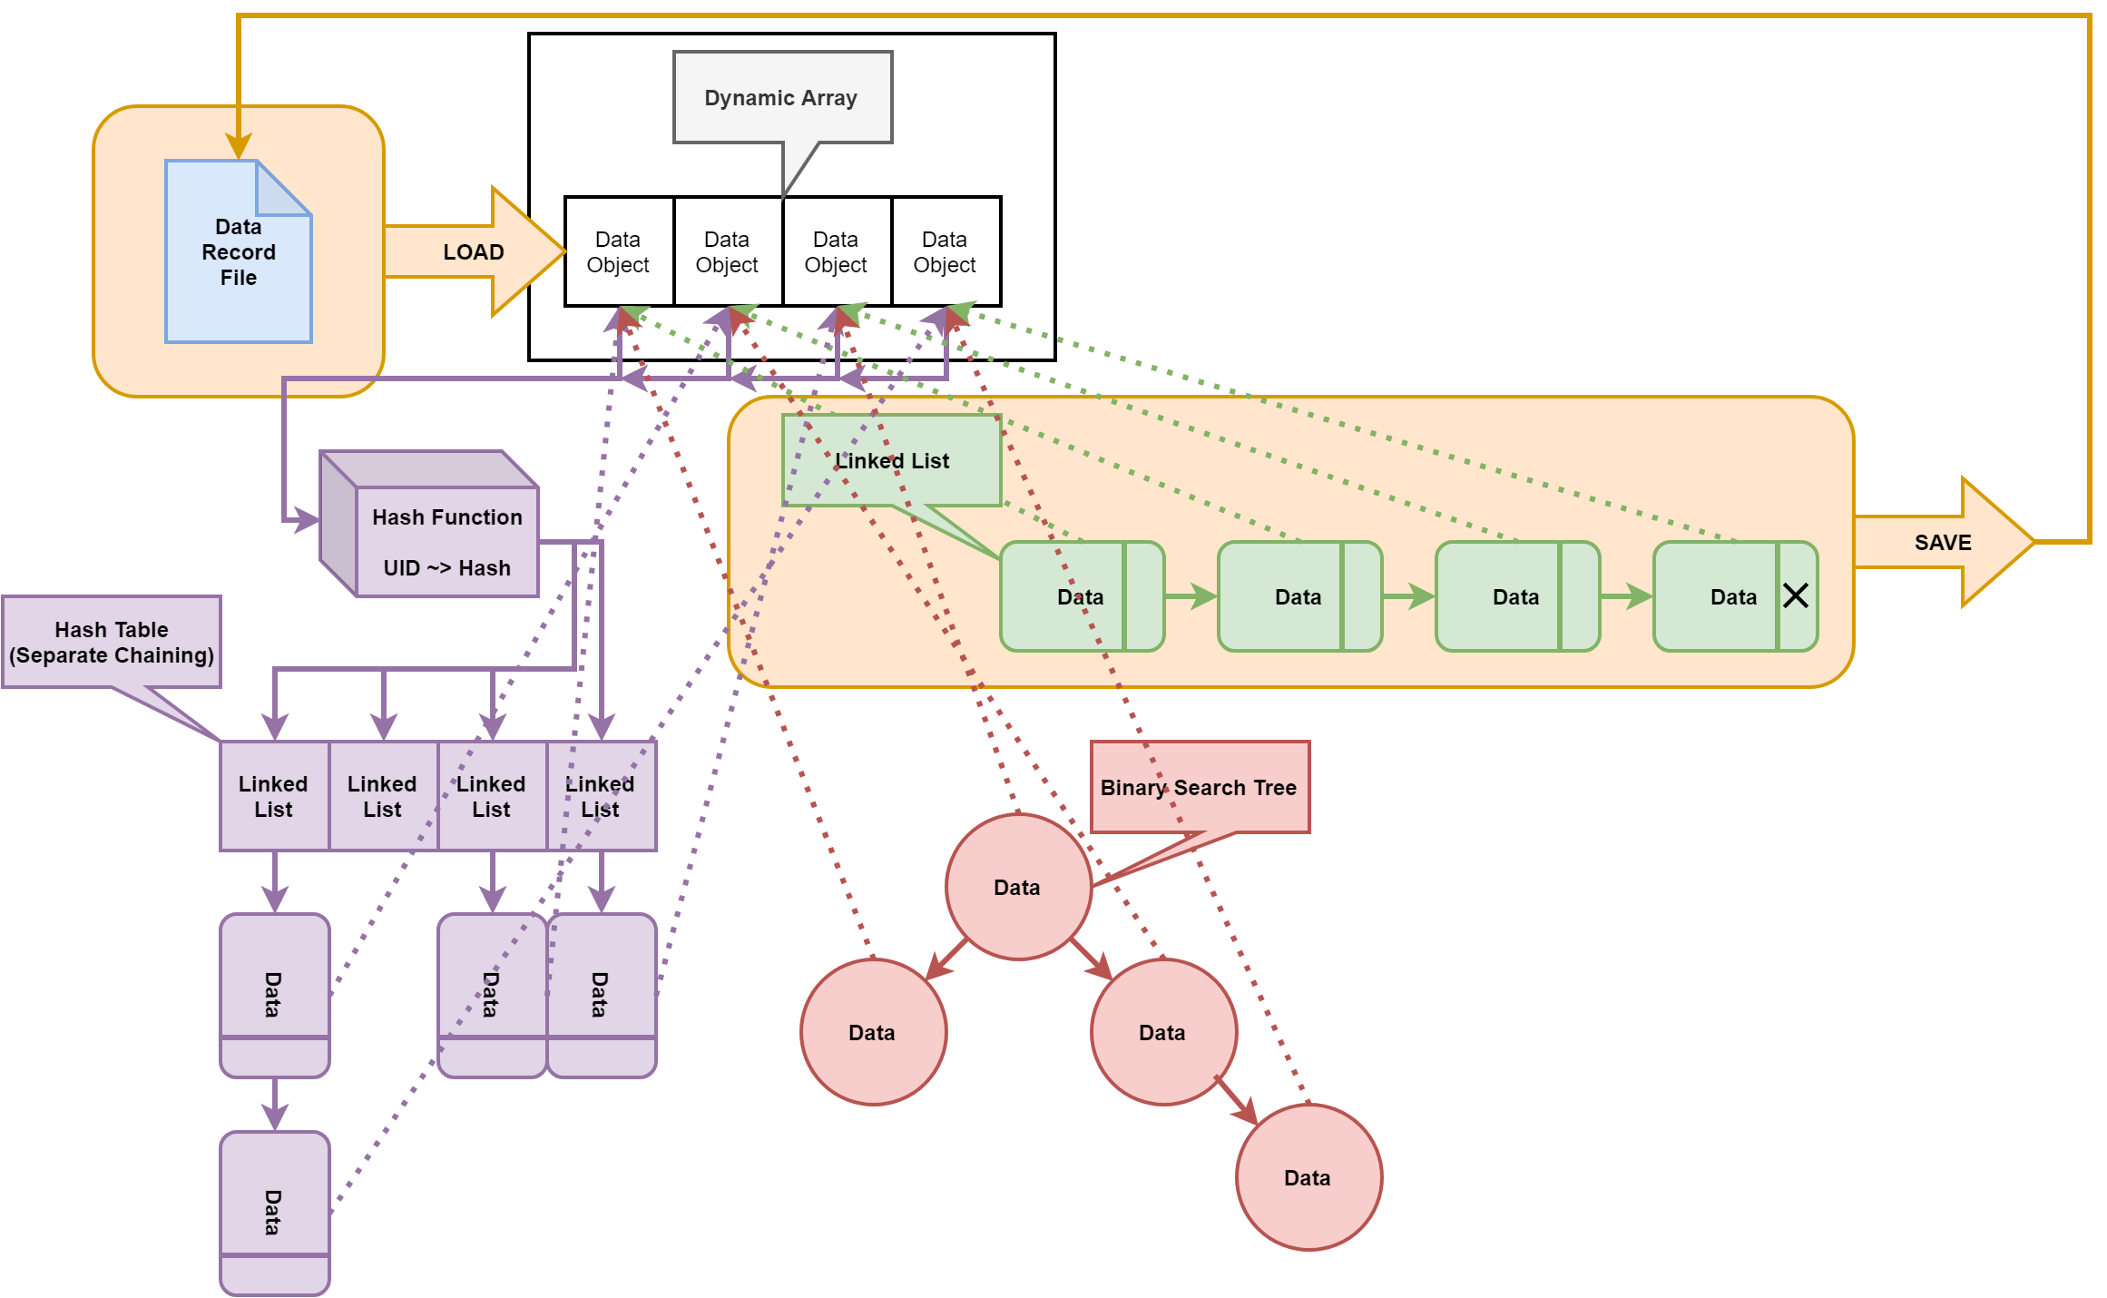
Data Structure Diagram

Slide 9
Demonstration
and
Q&A

